Slide 1

229 - I Will Wake The Dawn With Praises - Title

Slide 2
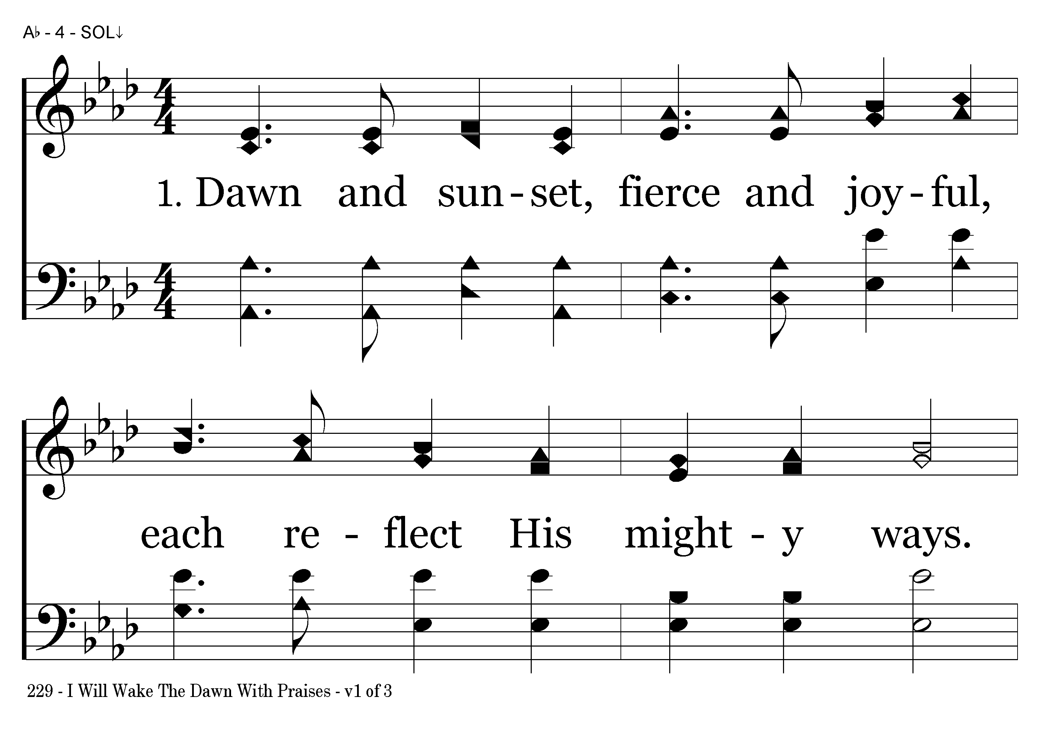
229 - I Will Wake The Dawn With Praises - 1.1

Slide 3
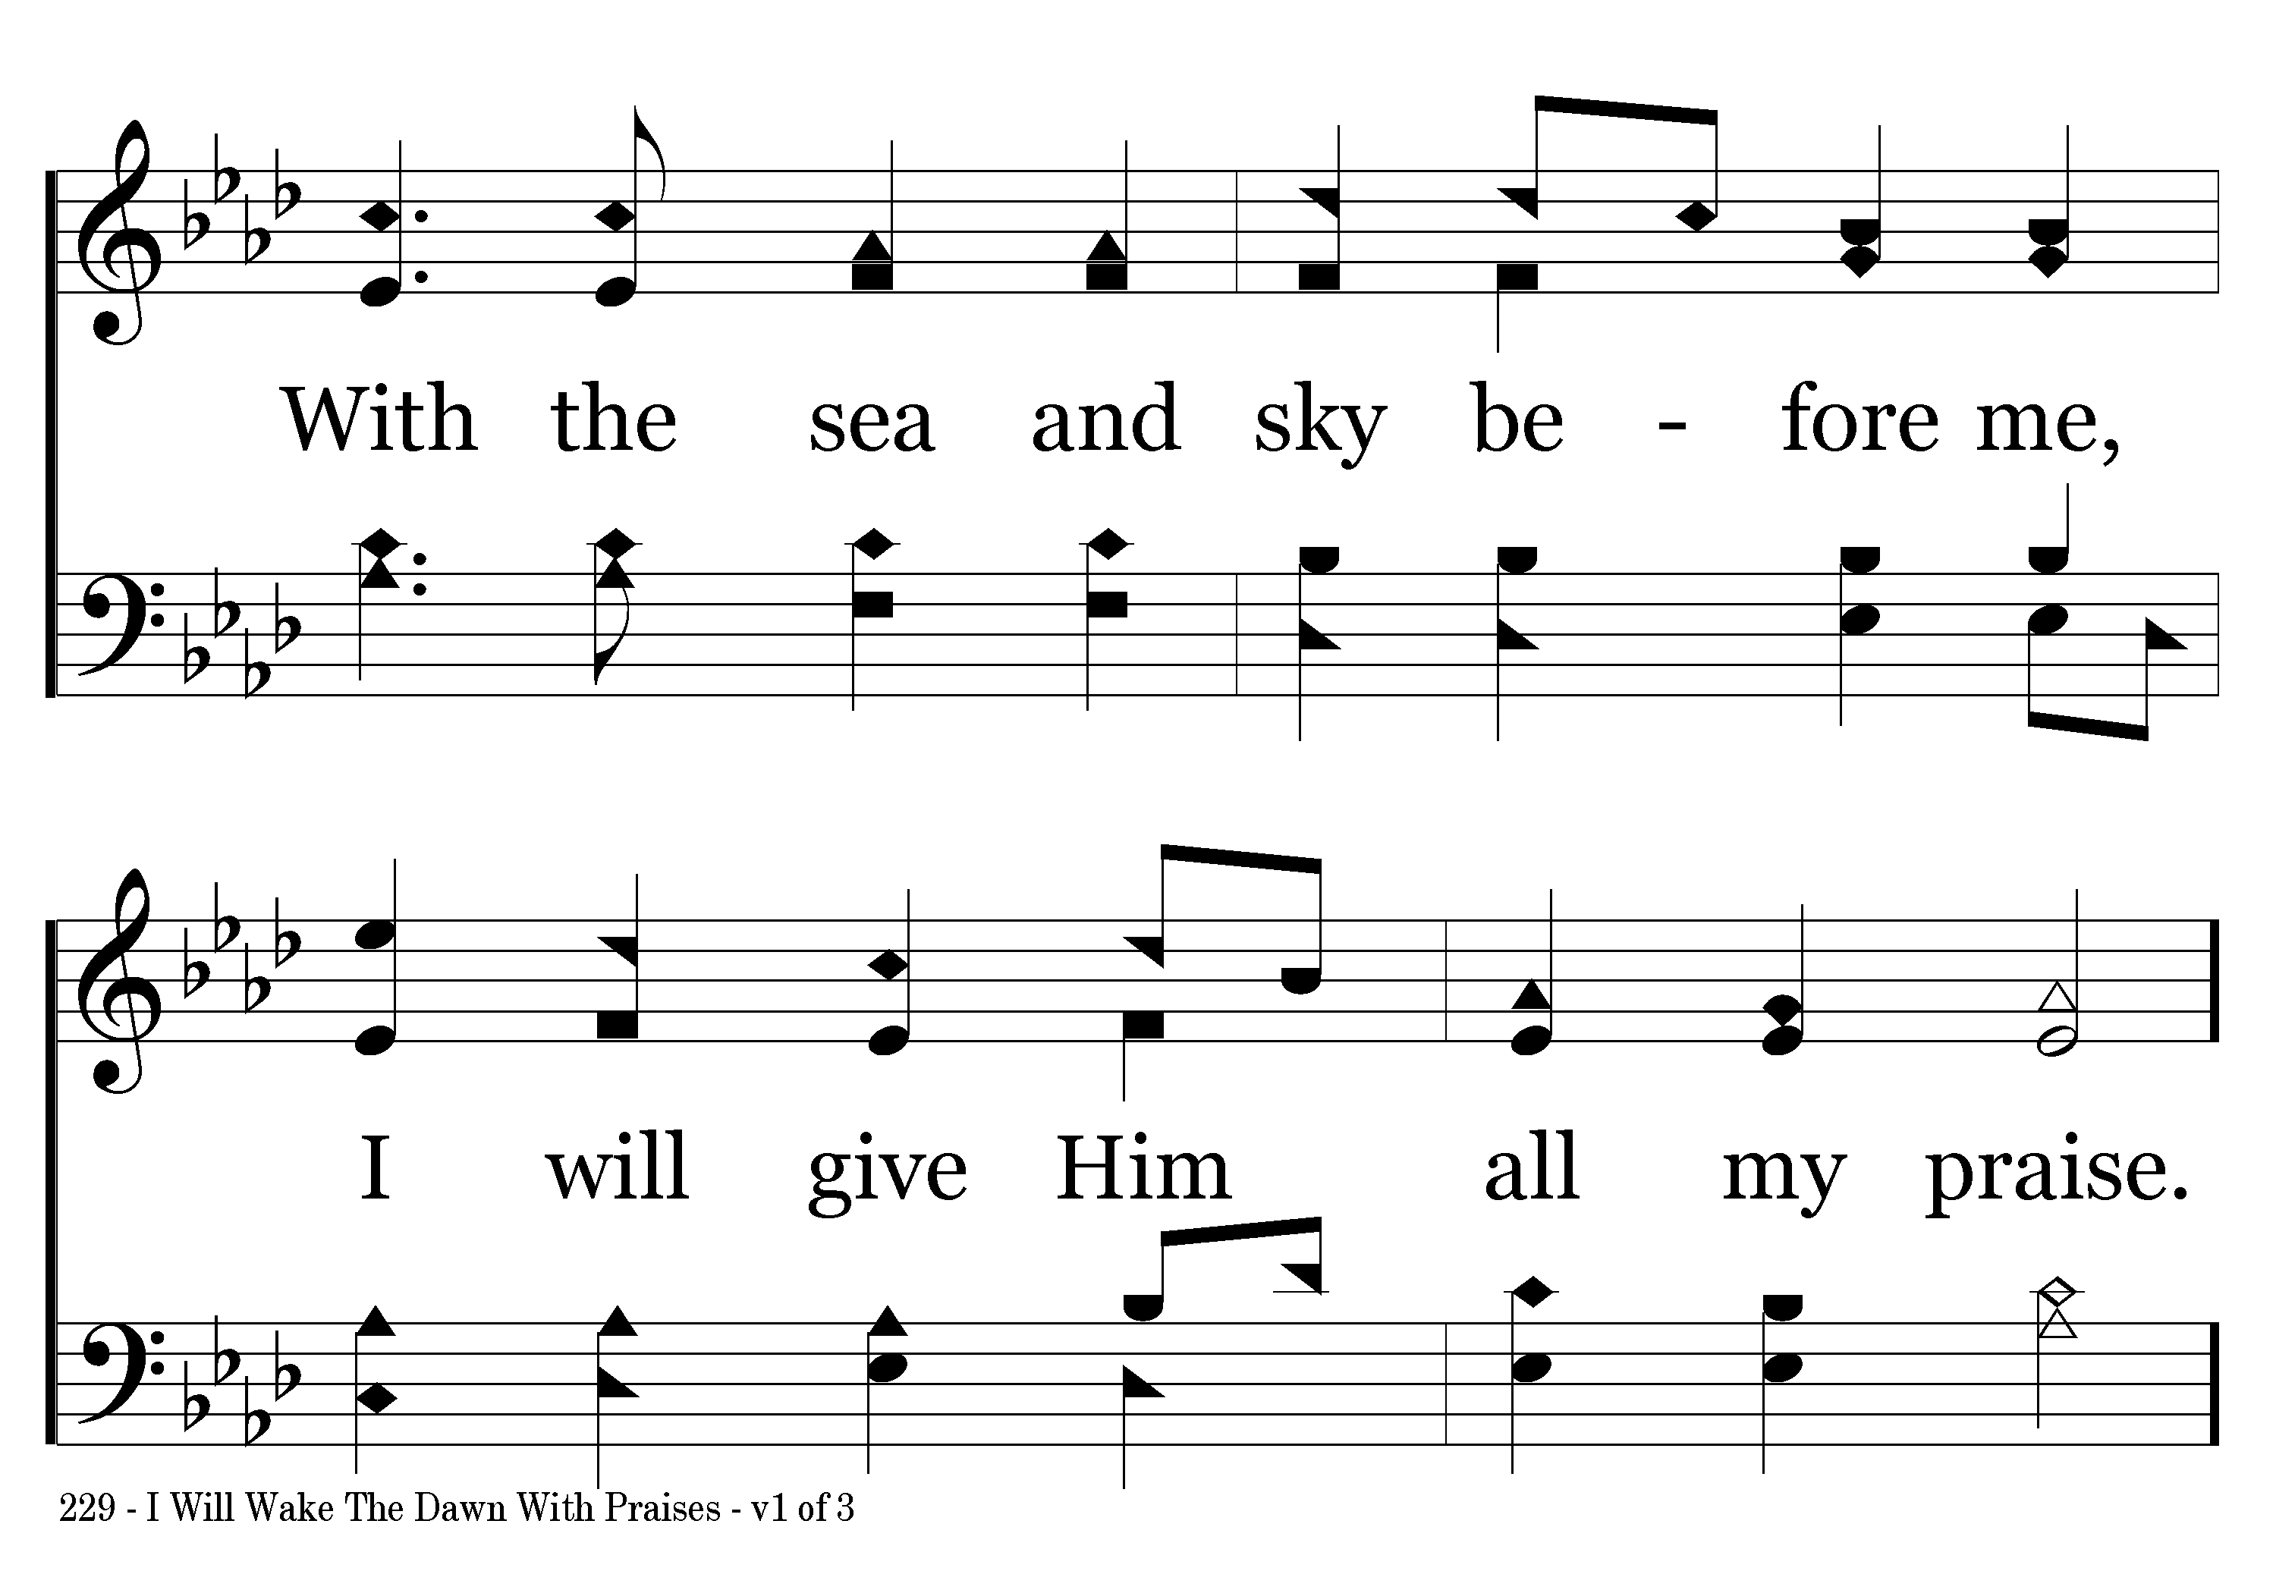
229 - I Will Wake The Dawn With Praises - 1.2

Slide 4
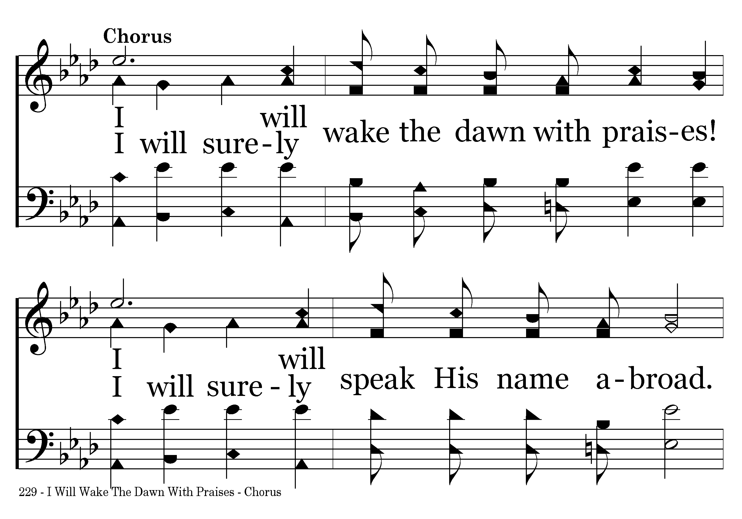
229 - I Will Wake The Dawn With Praises - C.1

Slide 5
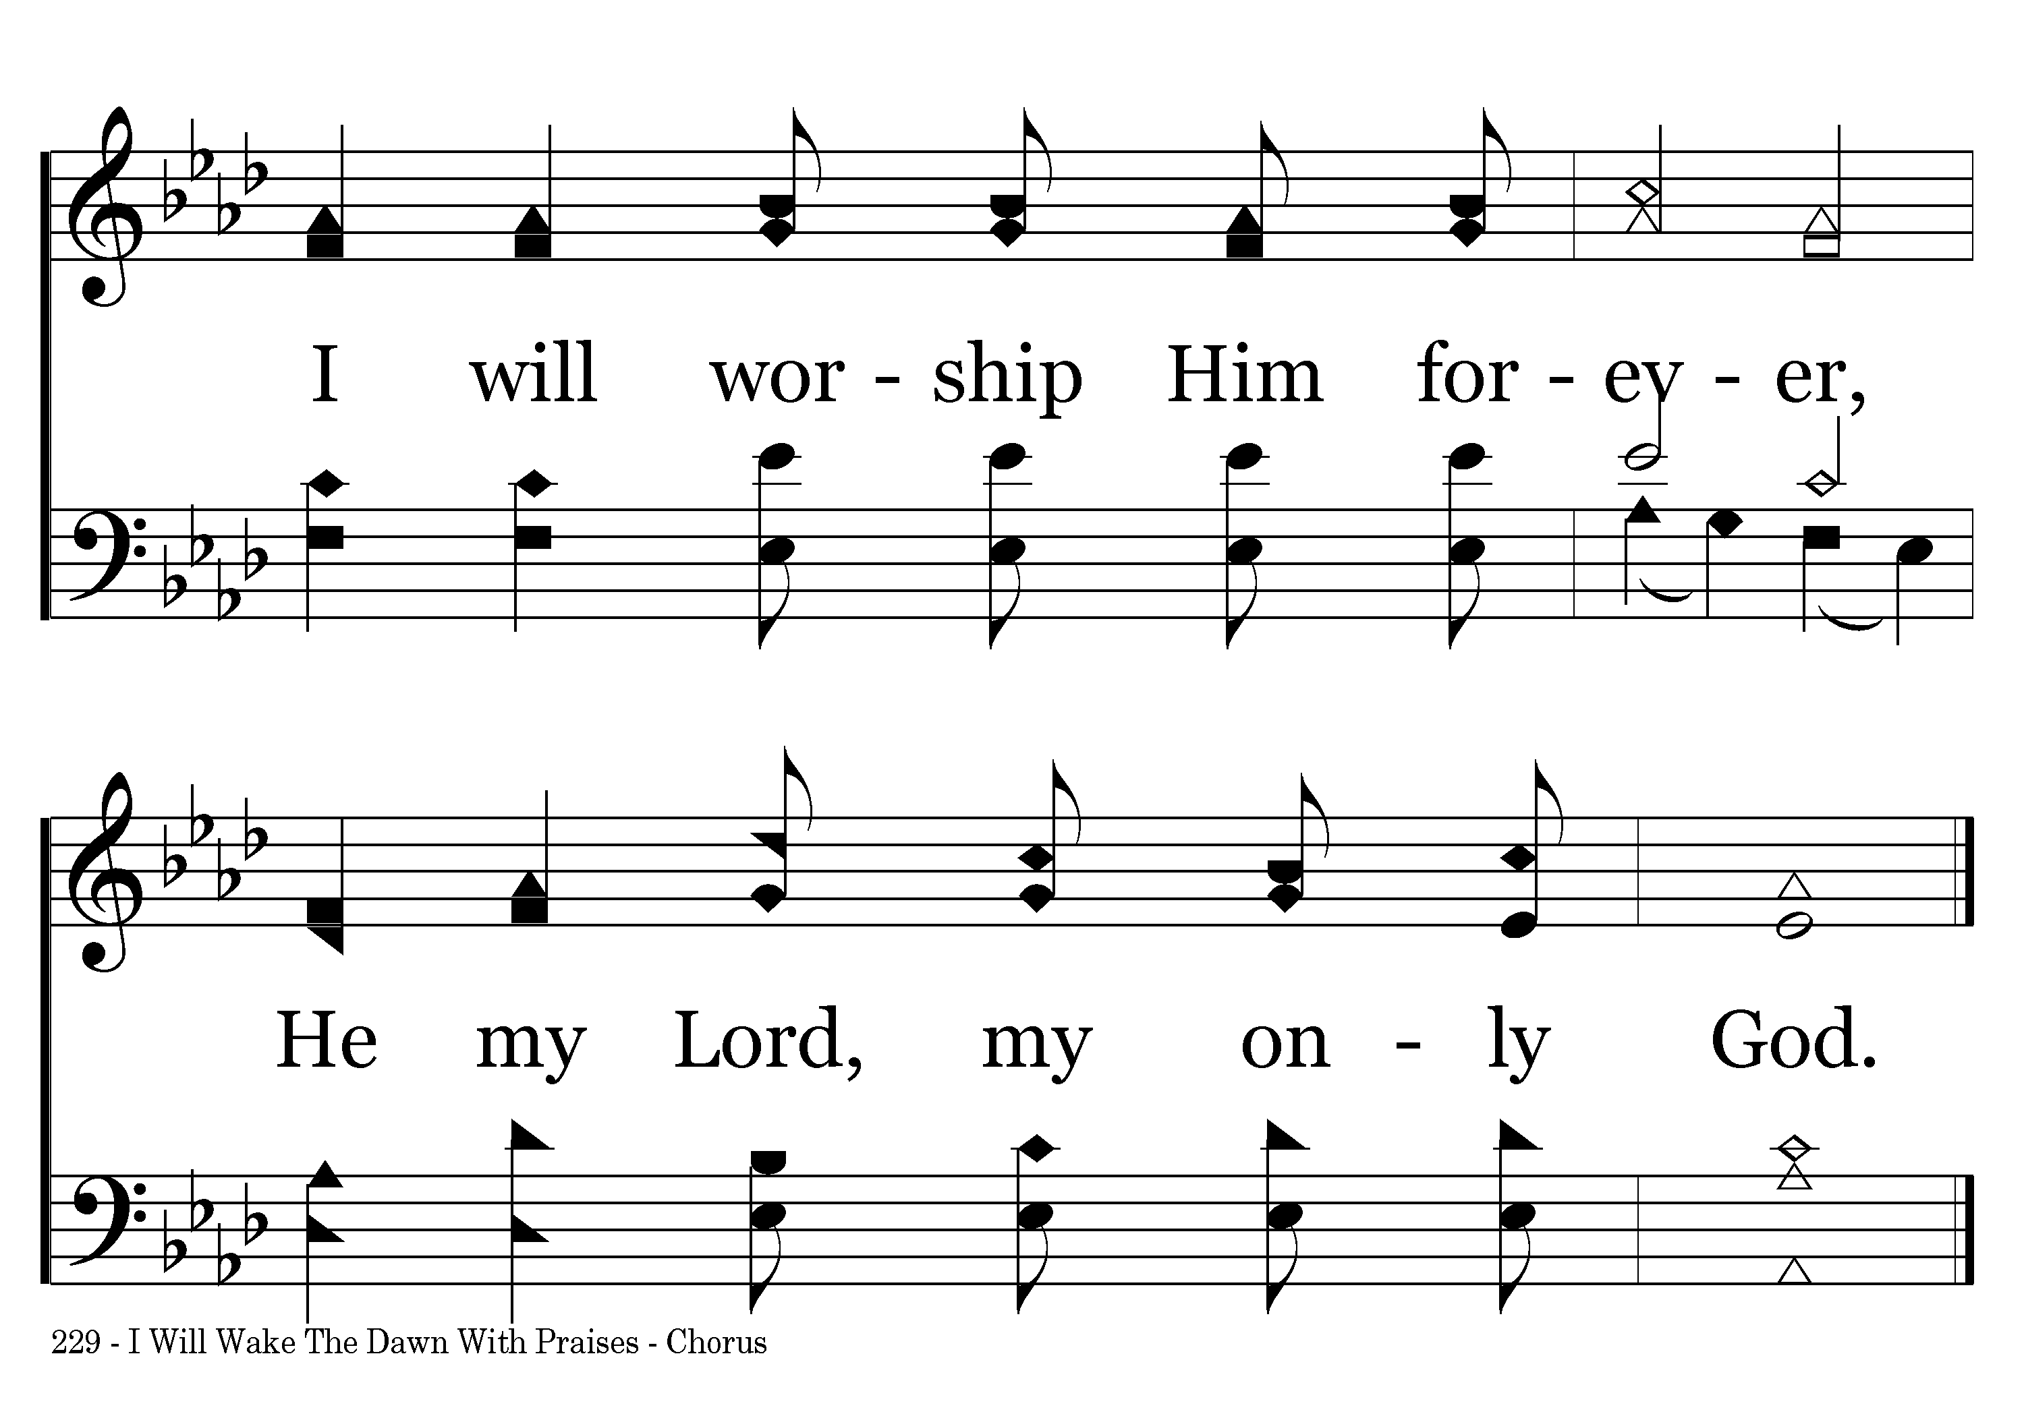
229 - I Will Wake The Dawn With Praises - C.2
End of Verse 1

Slide 6
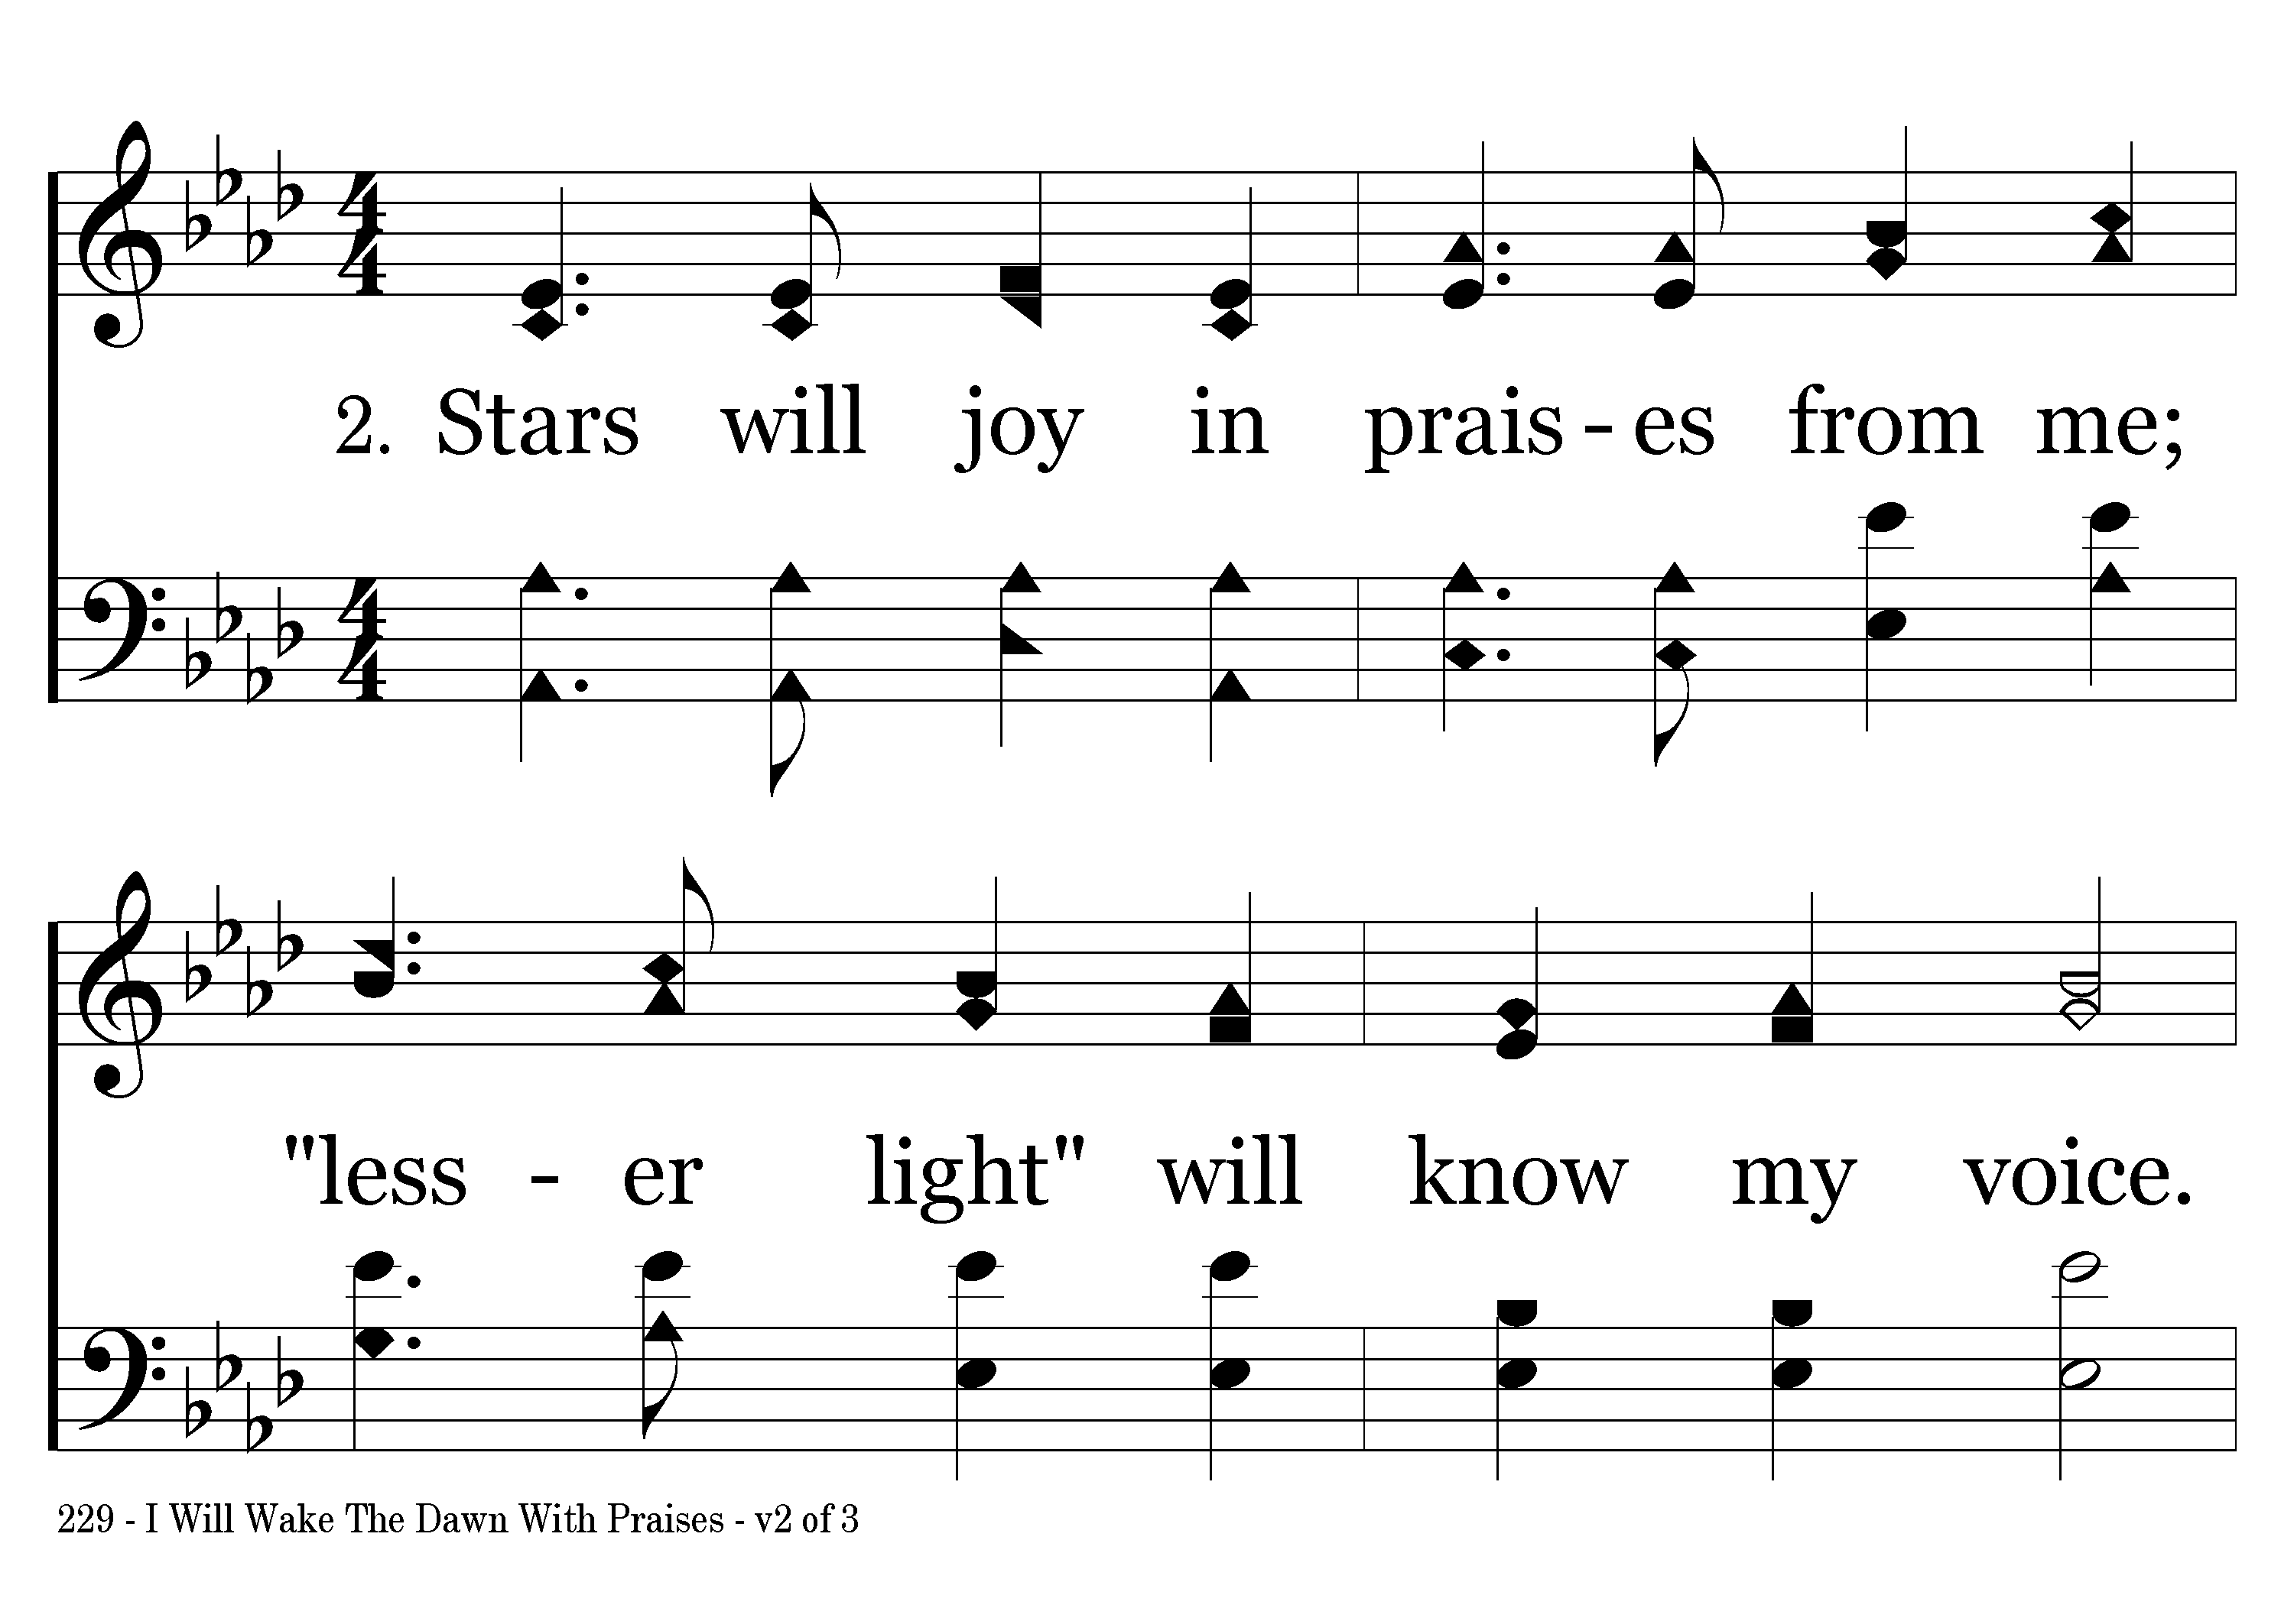
229 - I Will Wake The Dawn With Praises - 2.1

Slide 7
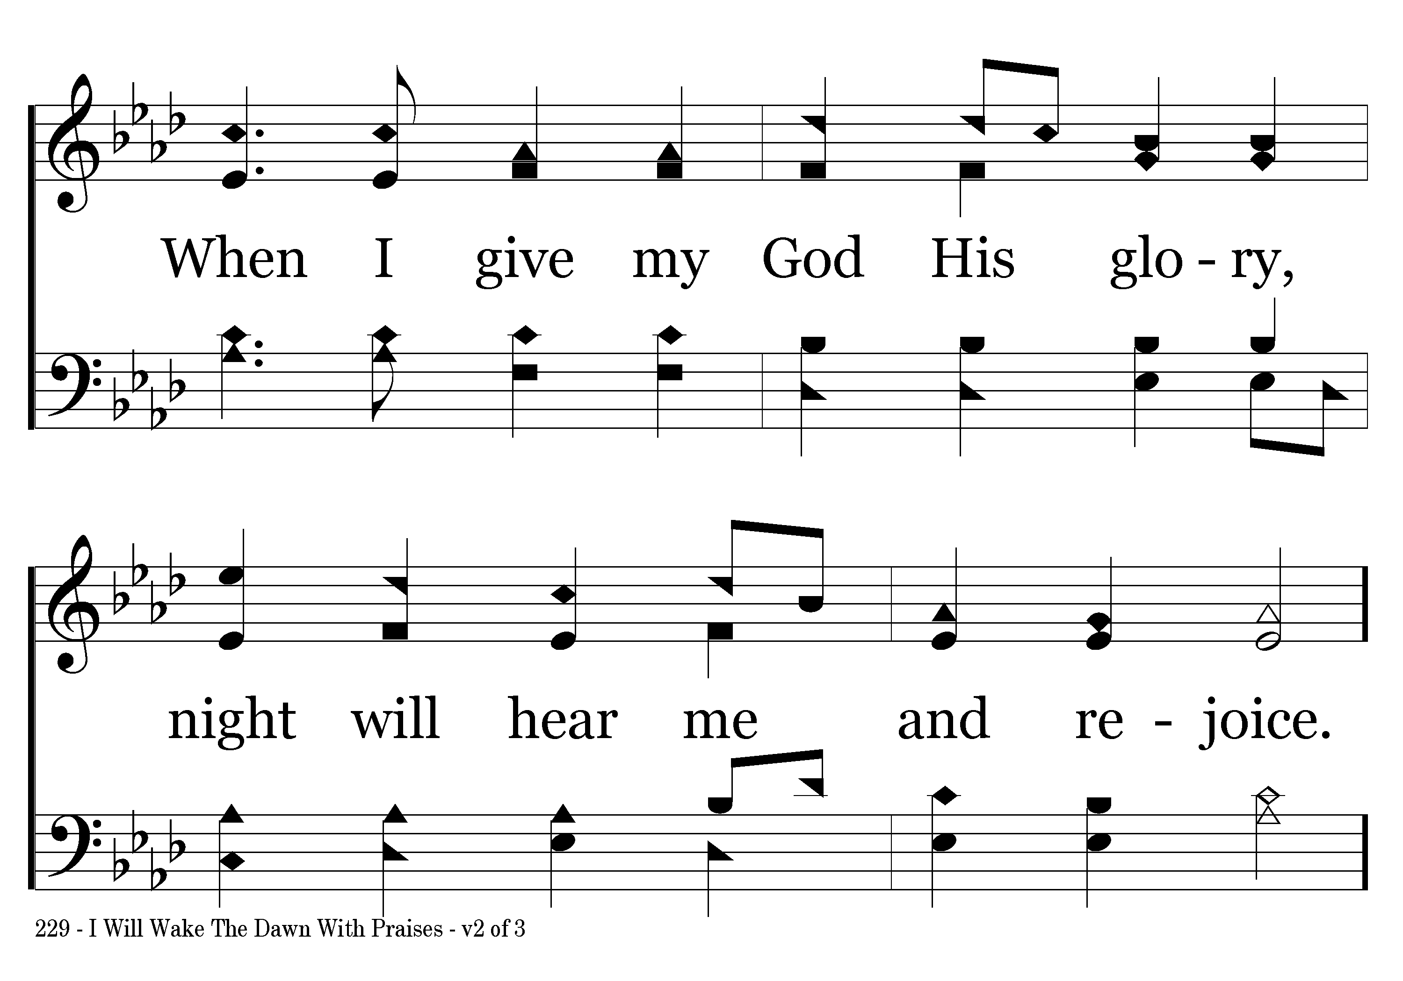
229 - I Will Wake The Dawn With Praises - 2.2

Slide 8
229 - I Will Wake The Dawn With Praises - C.1

Slide 9
229 - I Will Wake The Dawn With Praises - C.2
End of Verse 2

Slide 10
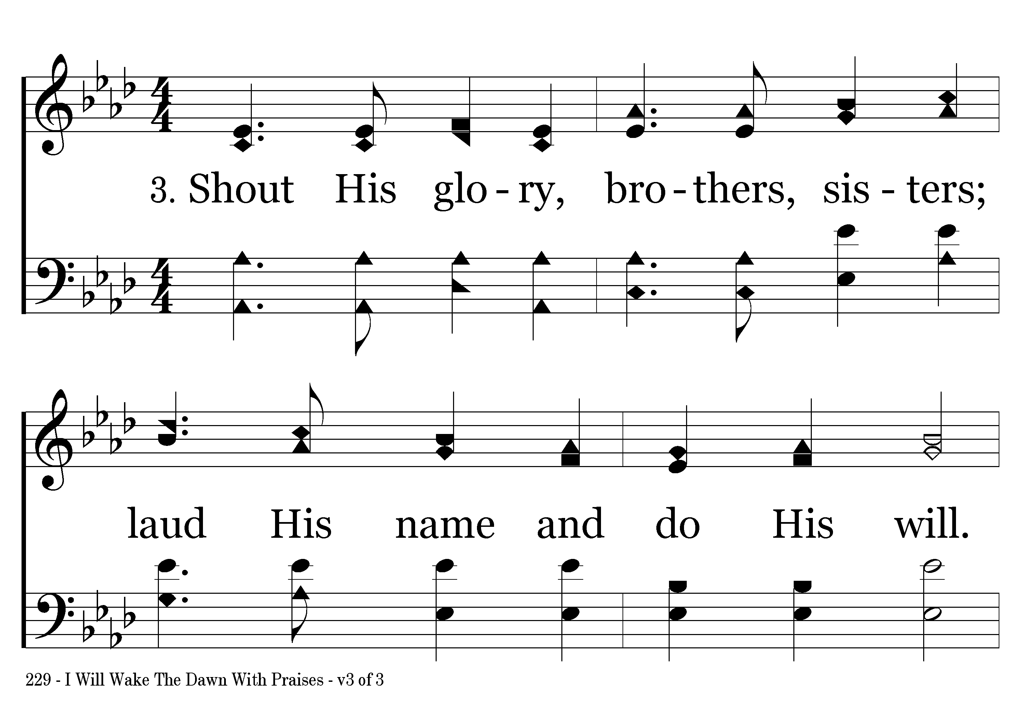
229 - I Will Wake The Dawn With Praises - 3.1

Slide 11
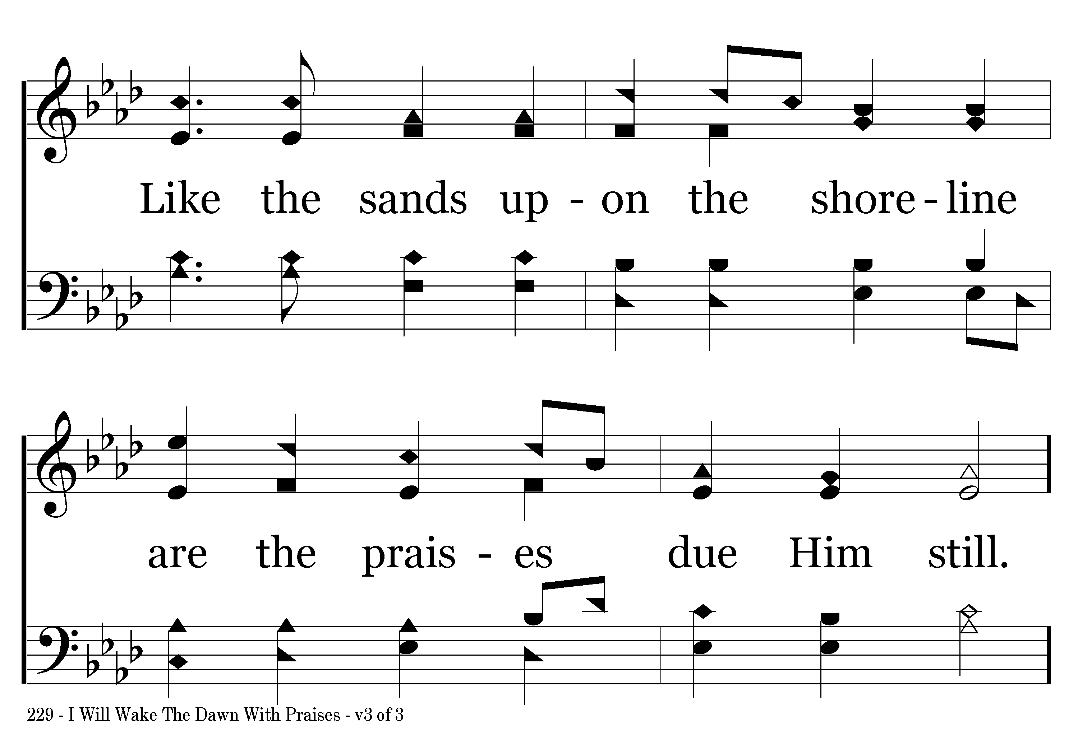
229 - I Will Wake The Dawn With Praises - 3.2

Slide 12
229 - I Will Wake The Dawn With Praises - C.1

Slide 13
229 - I Will Wake The Dawn With Praises - C.2
End of Song

